Slide 1


个人报告

Slide 2
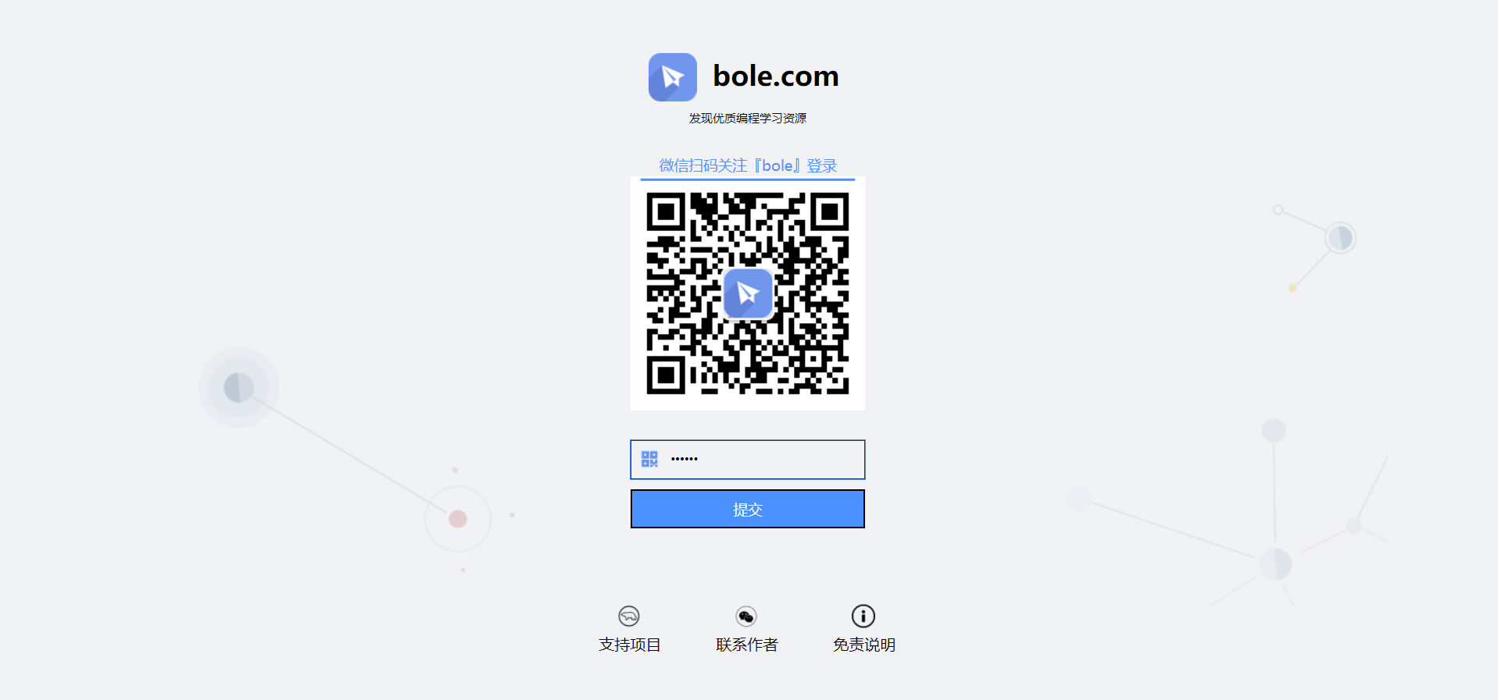

Slide 3
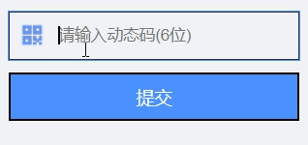
<form action="#" method="post">
<input type="password" autofocus placeholder="请输入动态码(6位)" pattern="^\d{6}$" maxlength="6" required/>
<input type="submit" onclick='window.open("index.html")' value="提交"/>
</form>

Slide 4


1600px(min)*100px
nav
1600(min)*730
150px
300*50
360*50
120*38
180*38
38*38
35px
1600px(min)*50px
1600px（min）*540px
230px*520px
1600px*520px
230px*520px
20px
div_btn

Slide 5


601*1040
100%*227
50px
100%*26px
20px
100%*131px
100%*420
50px
255px*31px
255px*370px
100%*370px
770px*26px
770px*362px
24px
27px
770px*312px
255px*312px

Slide 6

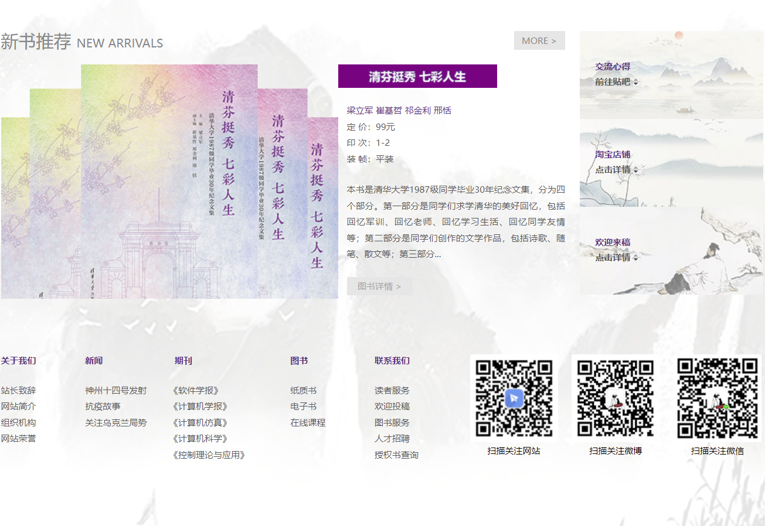
770px*26px
770px*365px
1040px*307px
260px
*
365px
20px
460px*320px
310px*320px
100%*310px
50px
1040px*260px
620px*260px
420px*260px
1600px(min)*50px

Slide 7


Slide 8
感谢观看！

